Slide 1
Auto Mock
Group 4
2008-5-17

Slide 2
Strategy
Regex (Regular Expressions)
  Fast
  Unreadable
  Limited
// Match fieldName.xxxxx(xxxxx)
String fieldInvokeRegex = "(" + fieldName + "[.](.*?)[(](.*?)[)])[; )]";
// this.localMethod(xxxxx)
// localMethod(xxxxx)
// = this.localMethod(xxxxx)
// (this.localMethod(xxxxx))
Pattern.compile("((?<=this[.])|[(]|\\s|=)(\\w+)[(].*?[)]");
Eclipse AST (Abstract Syntax Tree)
  Slow
  Understandable
  Promising

Slide 3
Design
Invocation
String content
boolean hasReturnValue
InvocationCount count
InvocationSequenceFinder
Invocation[] getInvocations(String fieldClassName)
IFieldNameFinder
String getFieldName(String fieldClassName)
RegexFieldNameFinder
RegexInvocationSequenceFinder
ASTFieldNameFinder
ASTInvocationSequenceFinder

Slide 4
Issues
// Local initialization
double temp = manager.withdraw(accountId, amount);
// Local assignment
temp = manager.withdraw(accountId, amount);
// Field assignment
this.result = manager.withdraw(accountId, amount);
// Array initialization
double arr[] = new double[] {manager.withdraw(accountId, amount)};
// Array element assignment
arr[0] = manager.withdraw(accountId, amount);
// Constructor argument
Double d = new Double(manager.withdraw(accountId, amount));
// method argument
fun(manager.withdraw(accountId, amount));
// condition statement
boolean res = !(manager.withdraw(accountId, amount) > 100 && 5 < amount);
// if statement
if (manager.needClose()) {
}
// while statement
while (manager.needClose()) {
}
// do statement
do {
} while (manager.needClose());
// for statement
for (int i = 0; manager.needClose(); i++) {
}
// return statement
return manager.withdraw(accountId, amount);
Return Value
  Regex
    Reflection
  AST
    Parent NodeType
ASSIGNMENT
VARIABLE_DECLARATION_FRAGMENT
INFIX_EXPRESSION
IF_STATEMENT
FOR_STATEMENT
WHILE_STATEMENT
RETURN_STATEMENT
METHOD_INVOCATION
DO_STATEMENT
CLASS_INSTANCE_CREATION
ARRAY_INITIALIZER

Slide 5
Issues
Cascade Invocations
  Regex
    Brute Force
  AST
    Method Declaration Map

Slide 6
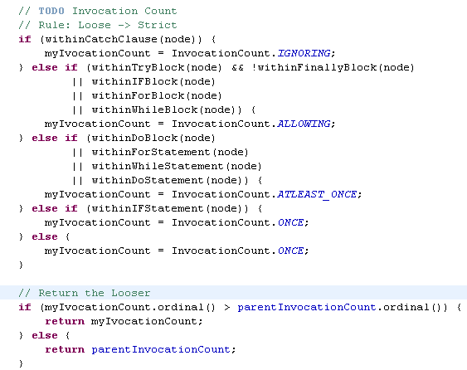
Issues
Invocation-level Propagation
  Regex
    X
  AST
    Parent Invocation Count
    My Invocation Count
    Mixed Invocation Count
ONCE
ATLEAST_ONCE
ALLOWING
IGNORING
Strict
Loose

Slide 7
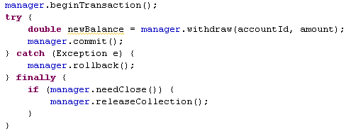
Example
Invocation | Has Return Value | InvocationCount
manager.beginTransaction() | FALSE | ONCE
manager.withdraw(accountId, amount) | TRUE | ALLOWING
manager.commit() | FALSE | ALLOWING
manager.rollback() | FALSE | IGNORING
manager.needClose() | TRUE | ONCE
manager.releaseCollection() | FALSE | ALLOWING

Slide 8
Corner
Overload Methods
Recursive Invocations

Slide 9
Next
Add more test cases to make it more reliable before integration
Deprecate old implementations and integrate with Eclipse Client

